Slide 1
Targeting Water Pollution and Hydroelectricity Potential Within Low-Income Areas
Jacquelyn Gomez
04/30/2021
Mr. Eisenberg

Slide 2
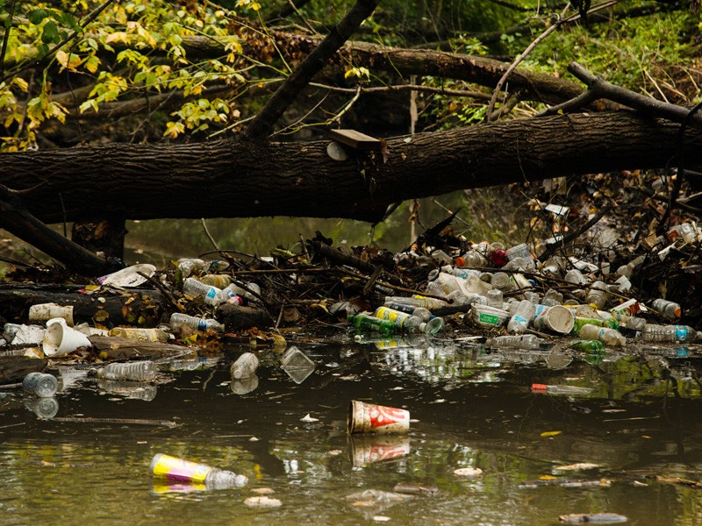
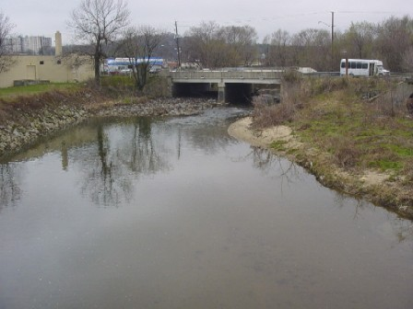
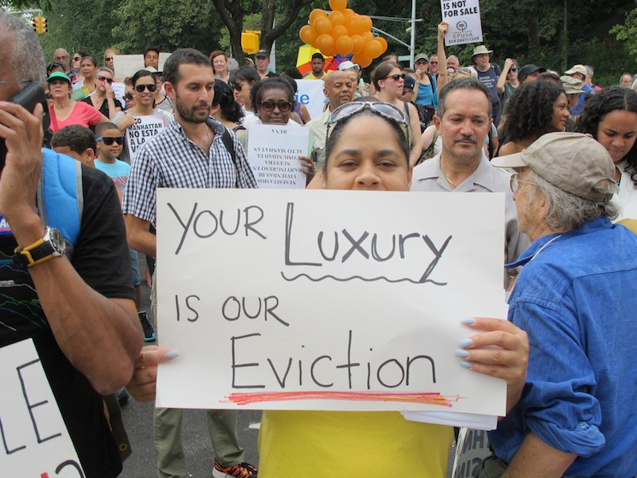
Introduction
Issues
Local pollution
Low-income communities
Social economic advantages
and disadvantages
Notes:
Environmental gentrification & Low-comeicommunities
Clean efforts benefit higher income classes the most
Cleaner environments lead to higher cost of living and property values
Environmental gentrification essential evicts low-income residents
This project…
Focused on aquatic pollution. Mainly the Anacostia River
The Anacostia river demonstrates poor health and surrounding communities are low-income
Production of hydroelectricity
Will be used as a means of financial relief

Slide 3
Problem
Can a device be designed and constructed to produce a substantial amount of electricity (~20V or more) and efficiently filter water?

Slide 4
Engineering Goals
The model will...
Decrease the TDS by ~25% or more
Decrease EC by at least ~15%
Produce a substantial amount of electricity measured in dc voltage
15-20V minimum
Have a pH of 6.5-8.5
Overall, the device should have an end result of cleaner water (visually cleaner) after going through the device and produce hydroelectricity

Slide 5
Methods
1
6
2
3
4
5
Start of Phase 1.
Selected water samples were tested for pre-TDS, EC and pH data.
Ran selected water sample through device for 5 minutes
Retested water sample for TDS, EC, and pH.
Conducted 10 trails per water sample for a total of 30 test trials.
Start of Phase 2
Modified the device by adding a turbine..
Conducted 10 with pre-filtered water while multimeter measured voltage output.
1
Start of Phase 1.
3
Retested water sample for TDS, EC, and pH.
4
Conducted 10 trails per water sample for a total of 30 test trials.
2
Ran selected water sample through device for 5 minutes
5
Start of Phase 2
6
Conducted 10 with pre-filtered water while multimeter measured voltage output.
Selected water samples were tested for pre-TDS, EC and pH data.
Modified the device by adding a turbine..

Slide 6
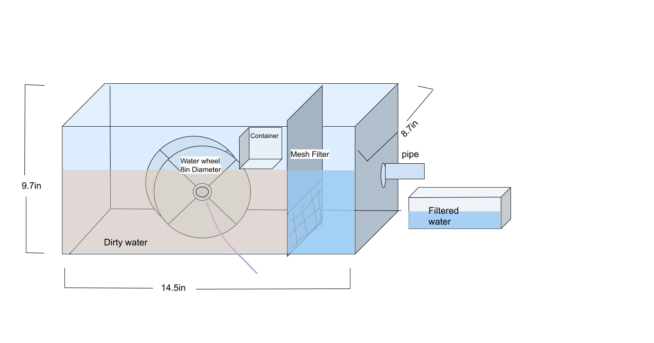
Proposed Device Design

Slide 7
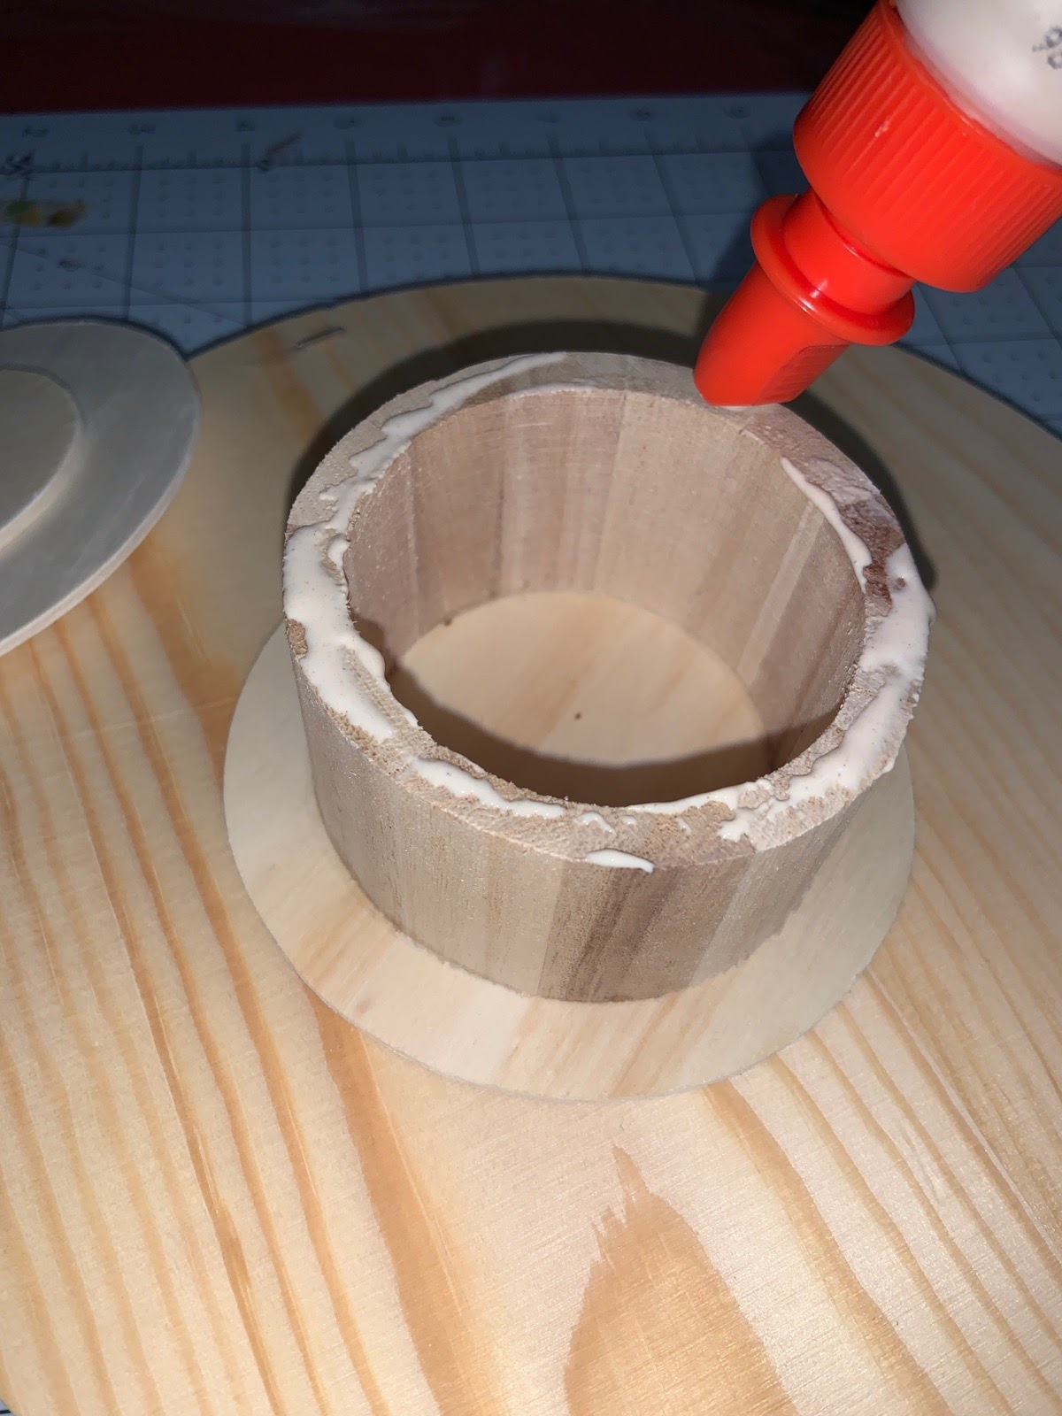
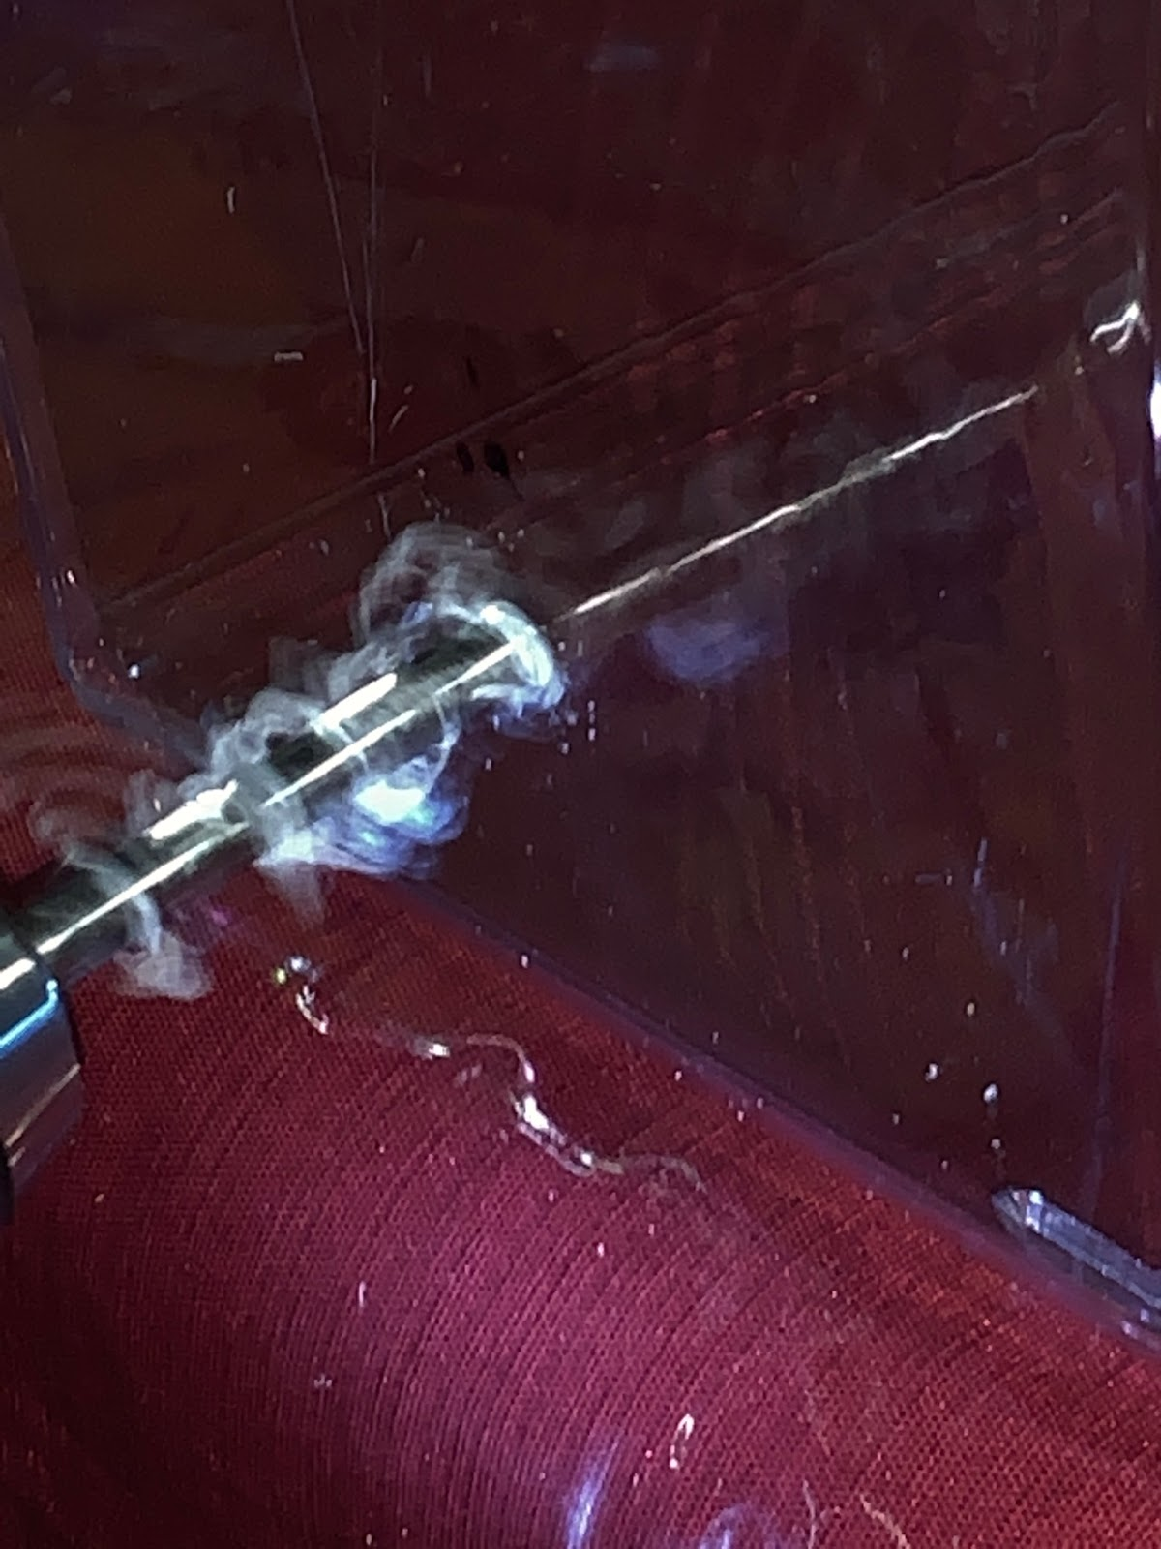
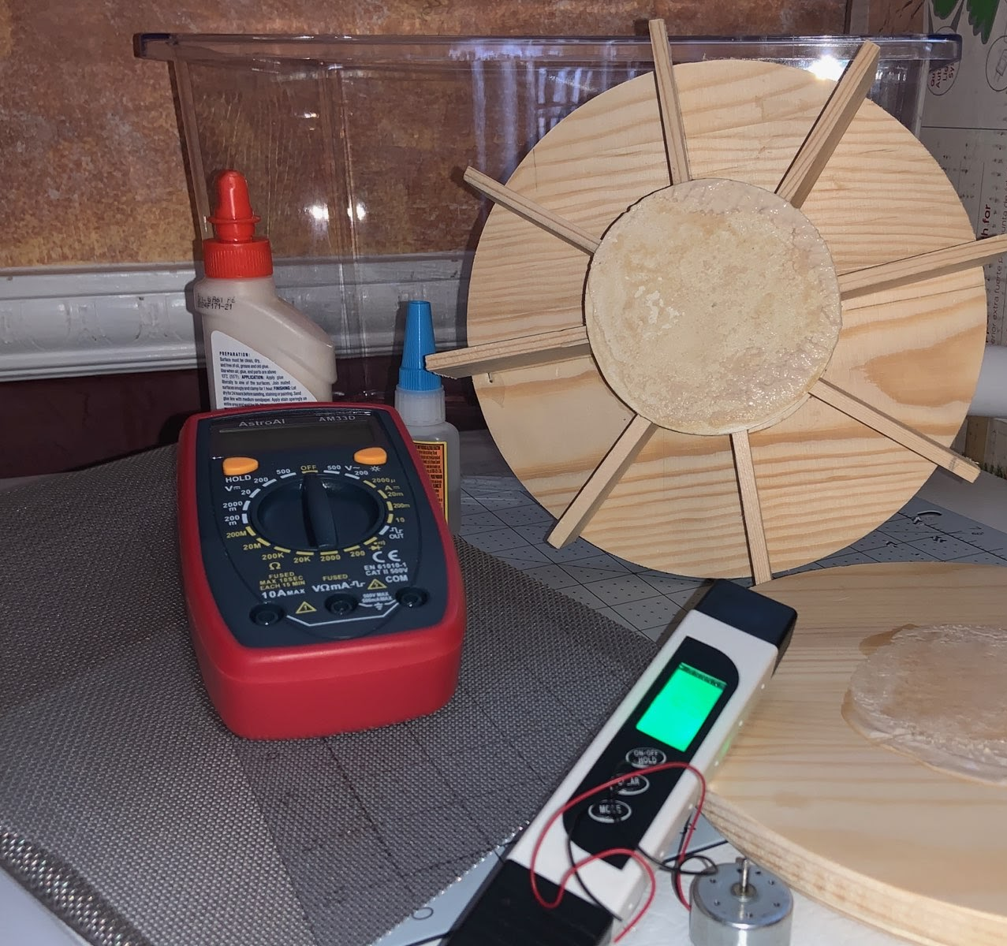
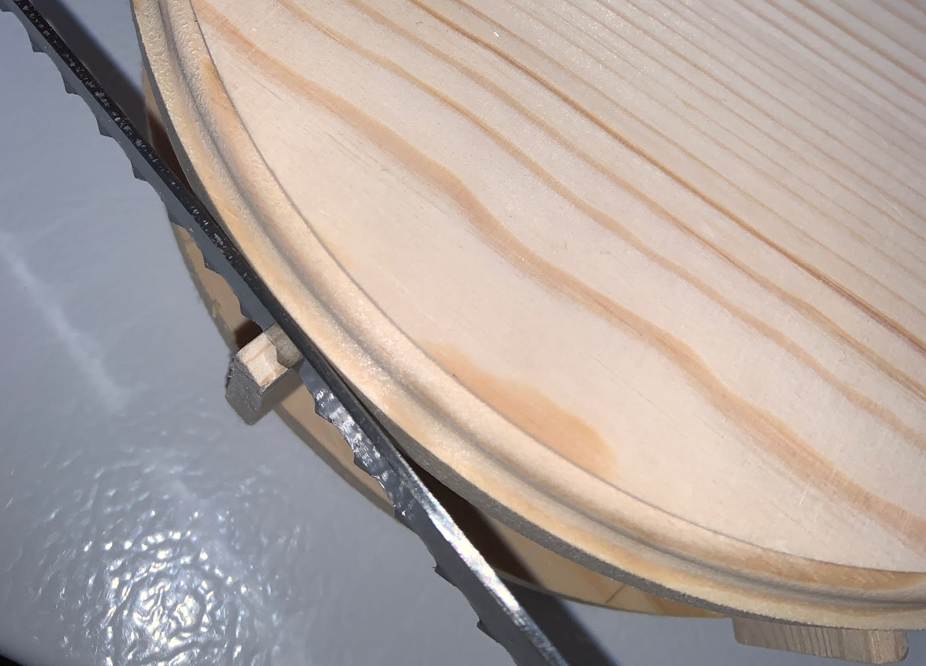
Construction

Slide 8
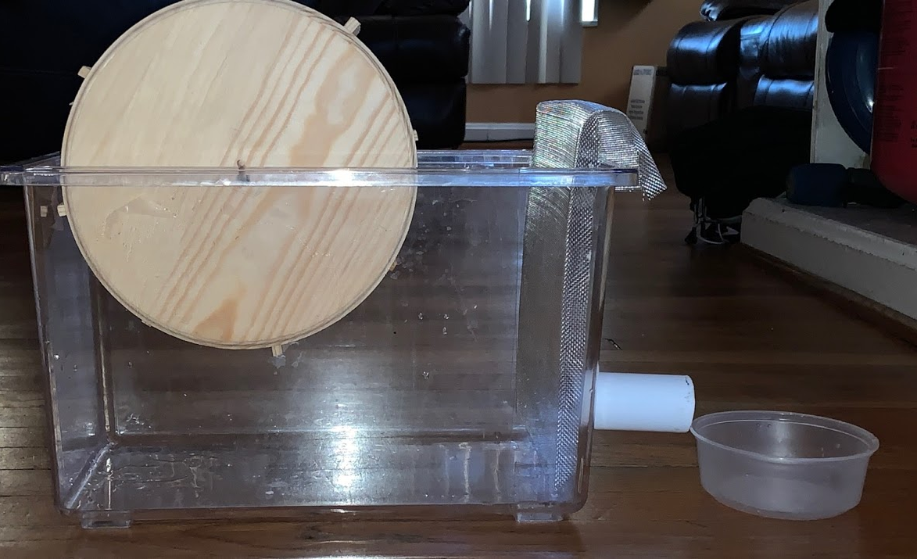
Current State of Device

Slide 9
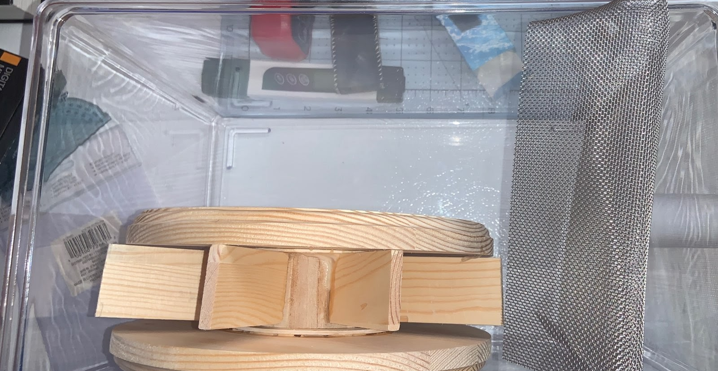
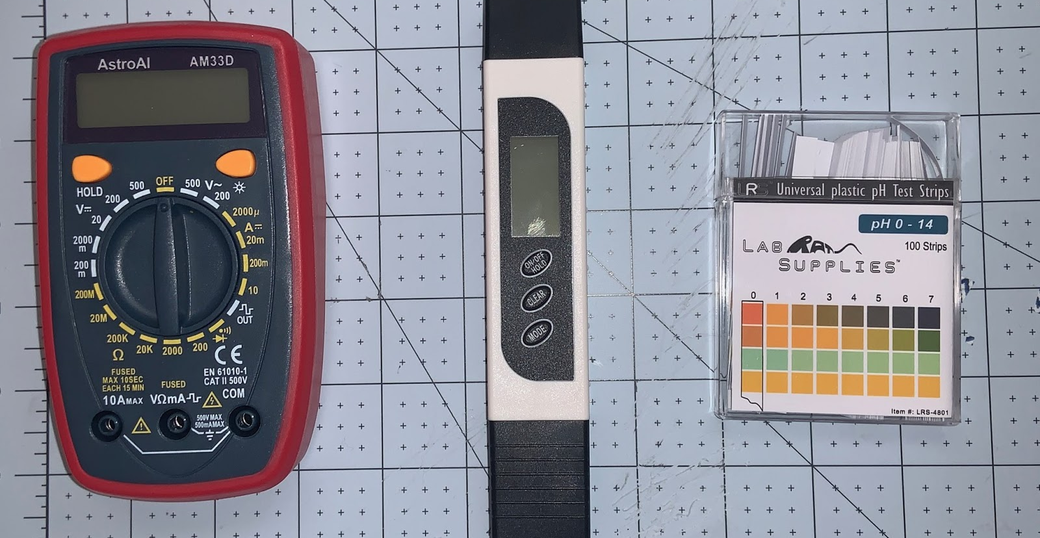
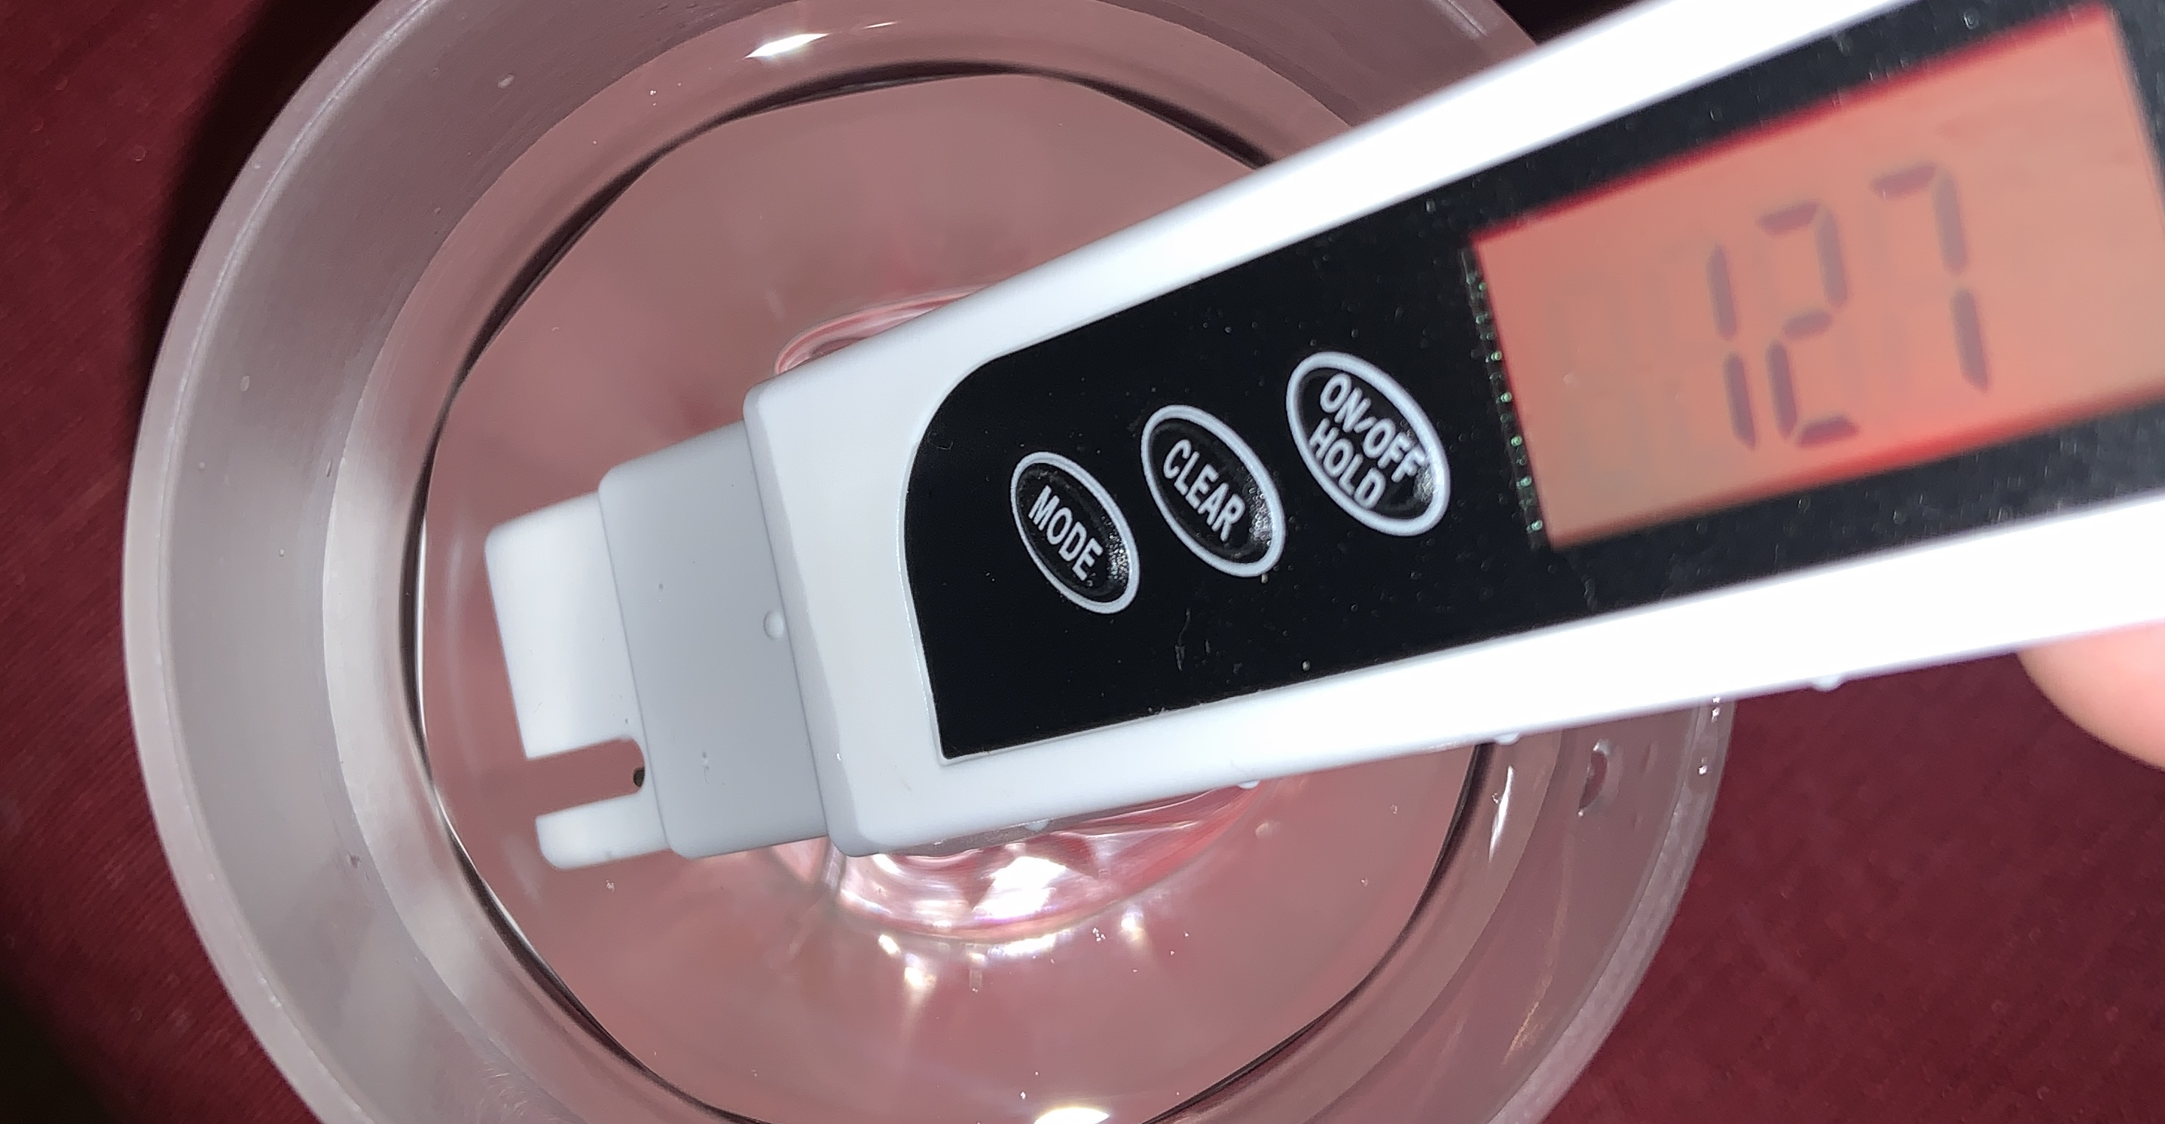
Major Components and Devices
DS Meter Digital Water Tester 3in1
Tested for EC (in μS/cm) and TDS (in ppm)
pH Strips
Measured for pH
Digital Multimeter
Measured for dc voltage (in V)
Water Wheel & Turbine
Produced hydroelectricity
Mesh Filter
Aids in filtering large components

Slide 10
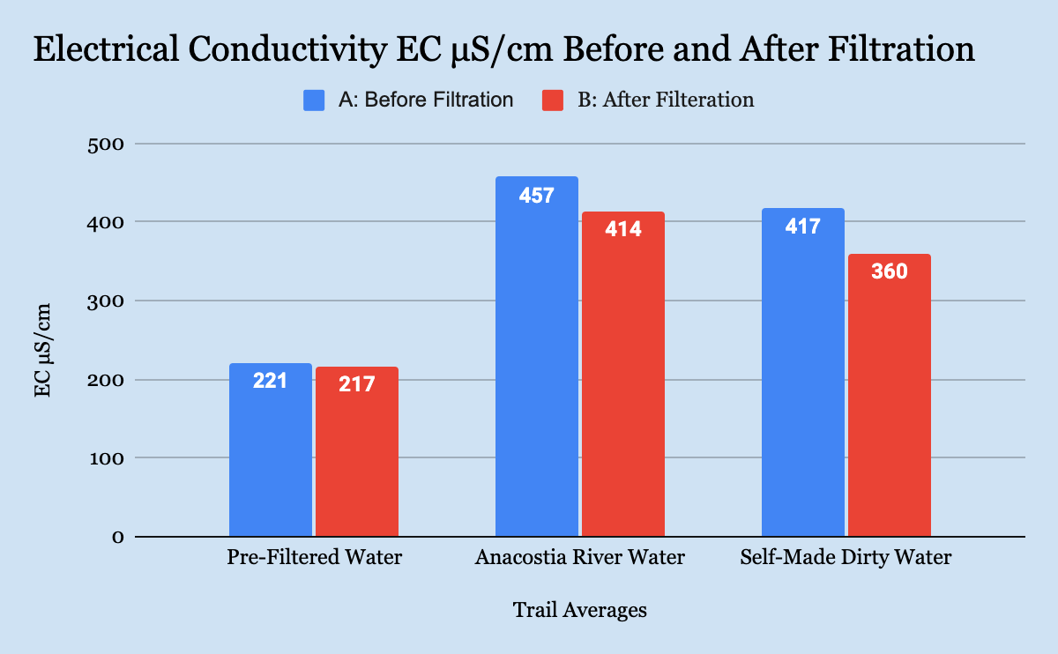
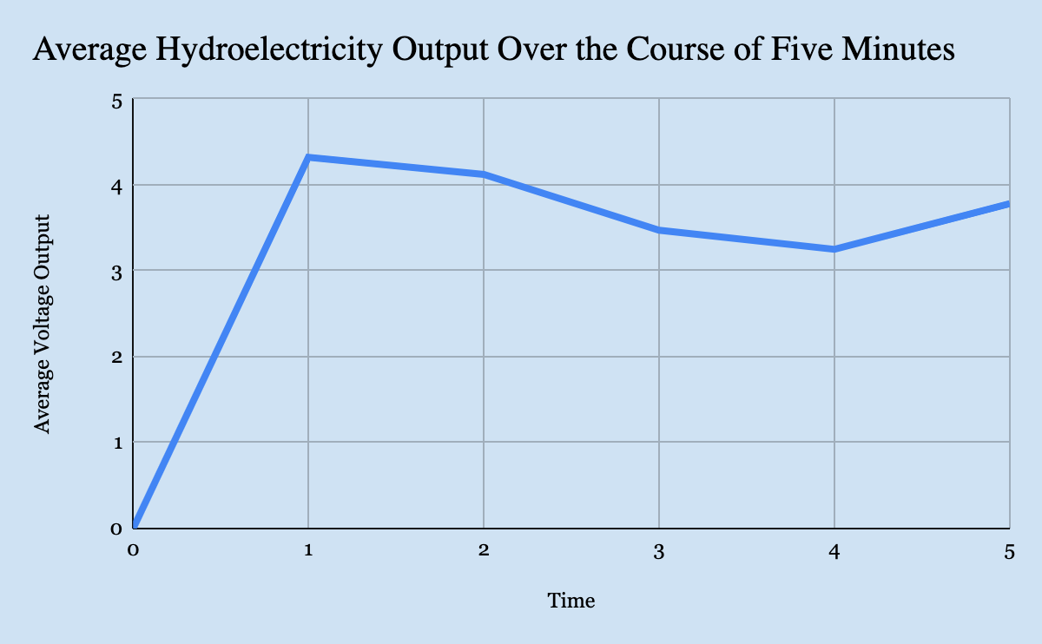
Graphs

Slide 11
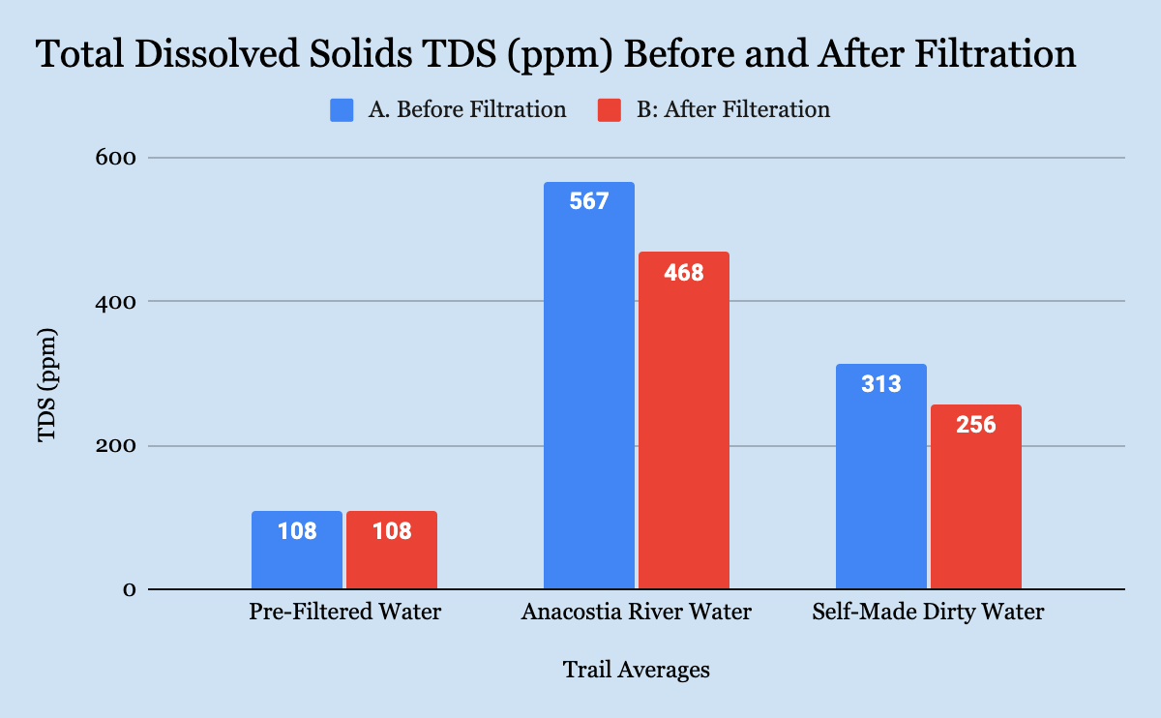
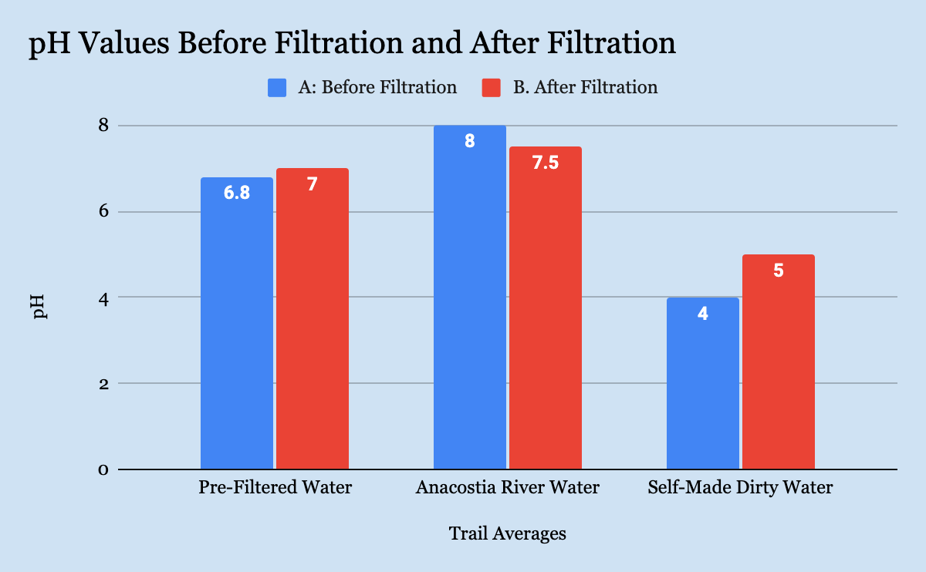
Summary Results
Improvements in..
TDS by an average of 18% ppm
EC by 8% μS/cm
pH in ideal ranges for pre-filter water sample and Anacostia River water
Hydroelectricity
Average production was 3.97 V
pH Self-Made Contaminated Water before and after were not in ideal range
Most engineering goals were not satisfied
Notes:
Improvements in..
TDS by an average of 18% ppm
EC by 8% μS/cm
pH in ideal ranges for pre-filter water sample and Anacostia River water
Hydroelectricity
Average production was 3.97 V
pH Self-Made Contaminated Water before and after were not in ideal range
Most engineering goals were not satisfied

Slide 12
Conclusion
Almost all test factors showed some type of improvement
Showed potential
Most outlined engineering goals were not accomplished
Future modifications and testing needed
At current state, device would not be able to significantly assist low-income communities due to unaccomplished of outlined goals

Slide 13
Future Research
Redesign
Focus on water wheel’s rotations ability and electrical output
More research on similar devices that focus on water quality factors and hydroelectricity output
Attempt to simulate river flow in redesign
Hypothetical scaling the device to…
Calculate the amount of electrical production in a real-life setting
Calculate amount of financial relief proved in a realistic setting
Notes:
Redesign and emphasize on hydroelectricity portions
Focus on water wheel’s rotations ability and electrical output
More research on devices that work towards improvement listed water quality factors and hydroelectricity output on a scale devices.
Attempt to simulate river flow in redesign
Hypothetical scaling the device to…
Calculate the amount of electrical production in a real-life setting
Calculate amount of financial relief proved in a realistic setting

Slide 14
Acknowledgements
I would like to thank Mr. David Eisenberg for his constant assistance, feedback, and understanding. I would also like to thank Mr. Paulino Gomez and Ms. Reyna Gomez for providing support throughout this project.

Slide 15
Thank you For Your Time!!

